Slide 1
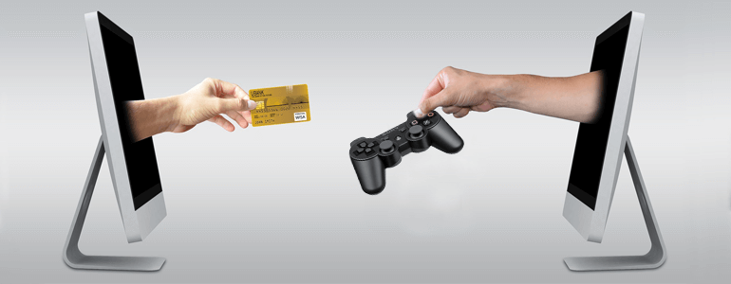
Running a Business

Slide 2
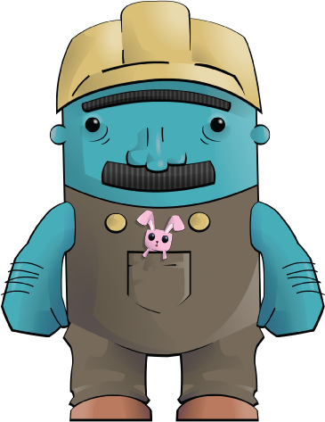
Running a Business
In this lesson, we will have a look at:
The structure of setting up a business.
The branding of a business.
Networking and promoting your business.
A business’ financial and tax obligations.

Slide 3
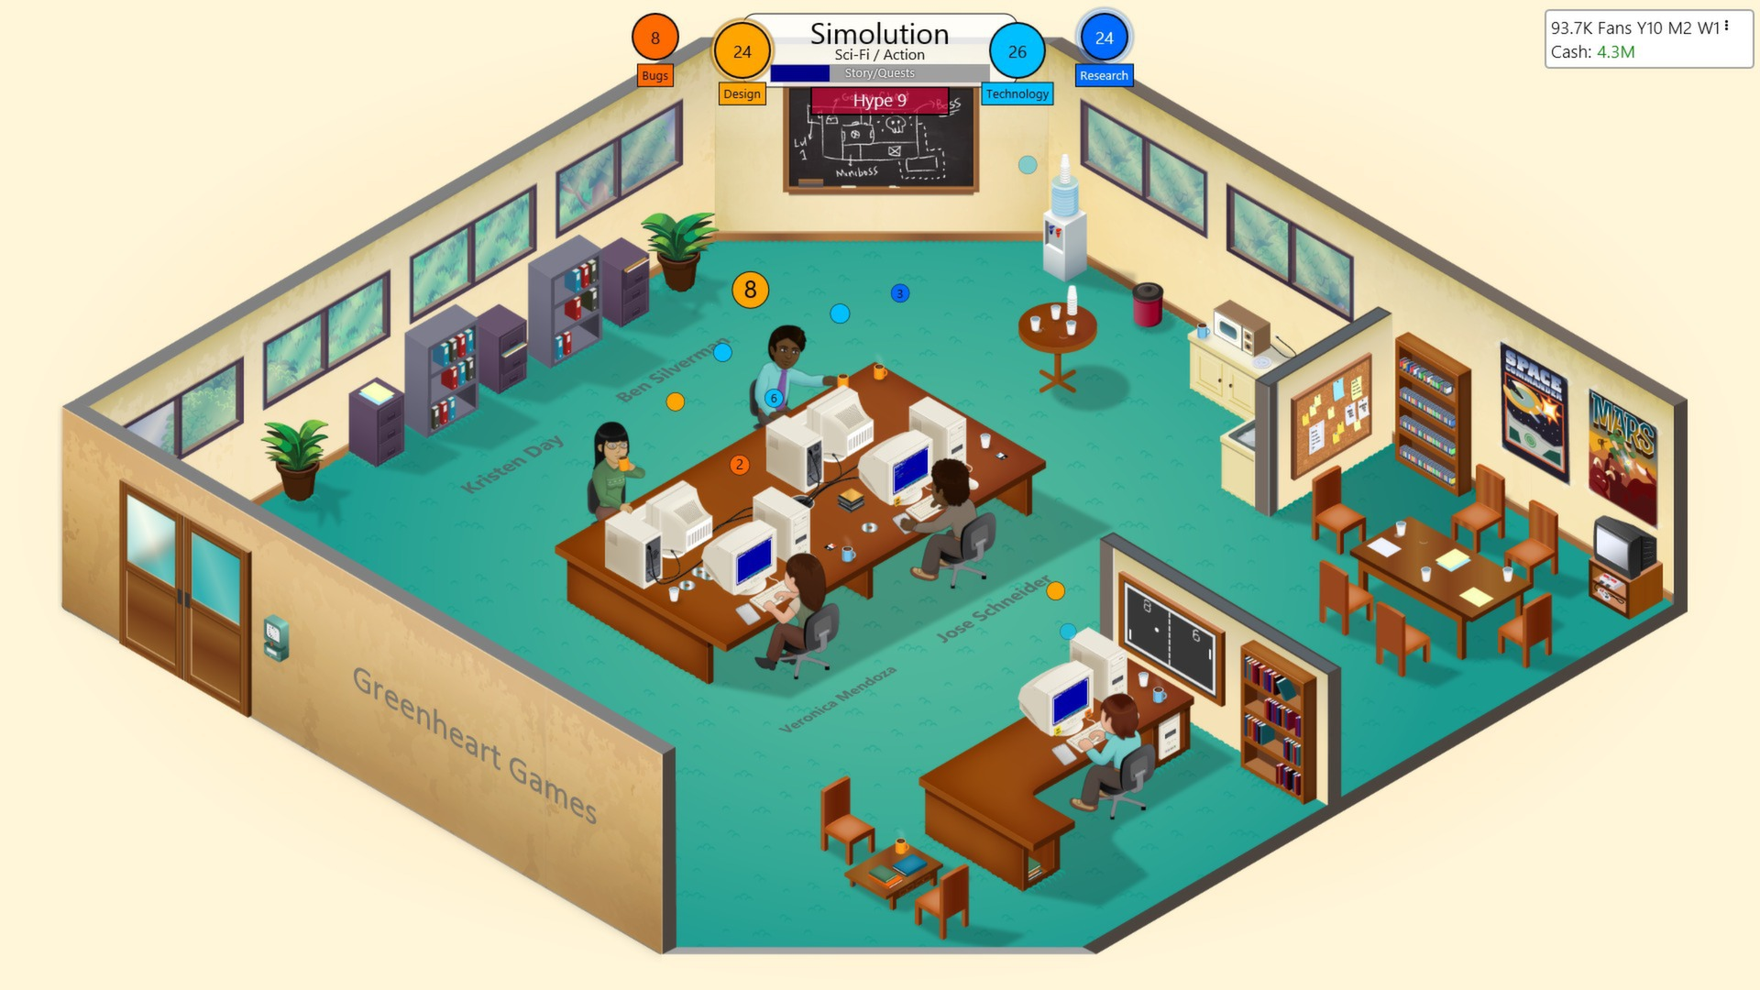

Game Dev – Running your own Business
Running your own business involves selling a product or providing a service for income and offsetting that with the expenses of running the business.
A typical Game Development Business involves:
Income from:
Building and selling games directly to customers.
Providing game development services to clients & businesses.
A mix of both.
Expenses include:
The cost of hardware and software.
Office rental, bills and equipment costs.
Wages and payments to staff and other service providers.

Slide 4

Business – Income, Profit and Taxation
A business is taxed based on the profit that they make.
As a business you are obligated to pay tax on your profit.
(business earnings minus your business costs)
Profit = Income – Expenses

Slide 5


Business – Structure
When starting a business there are a couple of options on how you would like to be set up.
Sole Trader
Taxed as individuals and reporting of business income is done through your personal tax returns.
More straightforward and less paperwork.
Subject to individual income tax rates.
Company
Established as a separate entity where the money earned, and liabilities, belongs to the company. (Which you may be a shareholder or work for)
More complex to set up and requires more paperwork and managing.
Subject to company tax rates.

Slide 6


Business – Branding
Your business branding is different from your business structure.
Your Brand is your business’s or product’s distinctive design and name.
This is used for marketing and promotional purposes and represents your reputation in the public eye.
You may register a Trademark to protect your business’ Brand or Products.
This gives you legal protection for the exclusive use of your branding.
This might include names, slogans, words, phrases, logos, colour combinations, shapes and design layouts.

Slide 7
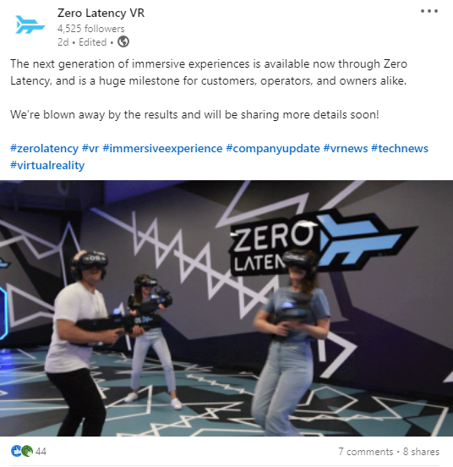
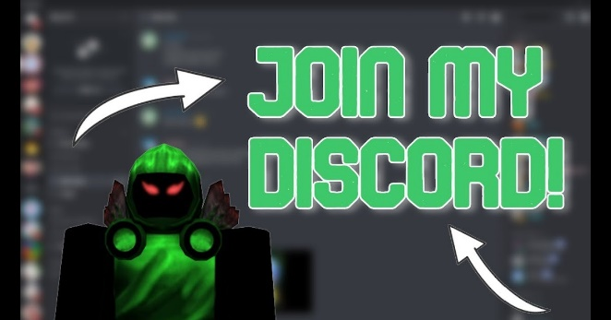
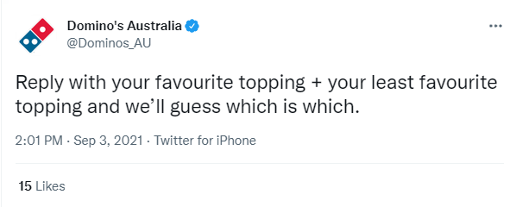
Business – Promotion and Networking
It is important to put in effort in promoting your business and your work.
Brand recognition will help you get more customers & clients.
Social networking allows you to create profiles and is a great way to promote, connect and engage with the community and your network.
Examples include:
Twitter Profiles.
Discord Servers.
Facebook Pages.
LinkedIn Pages and Profiles.

Slide 8

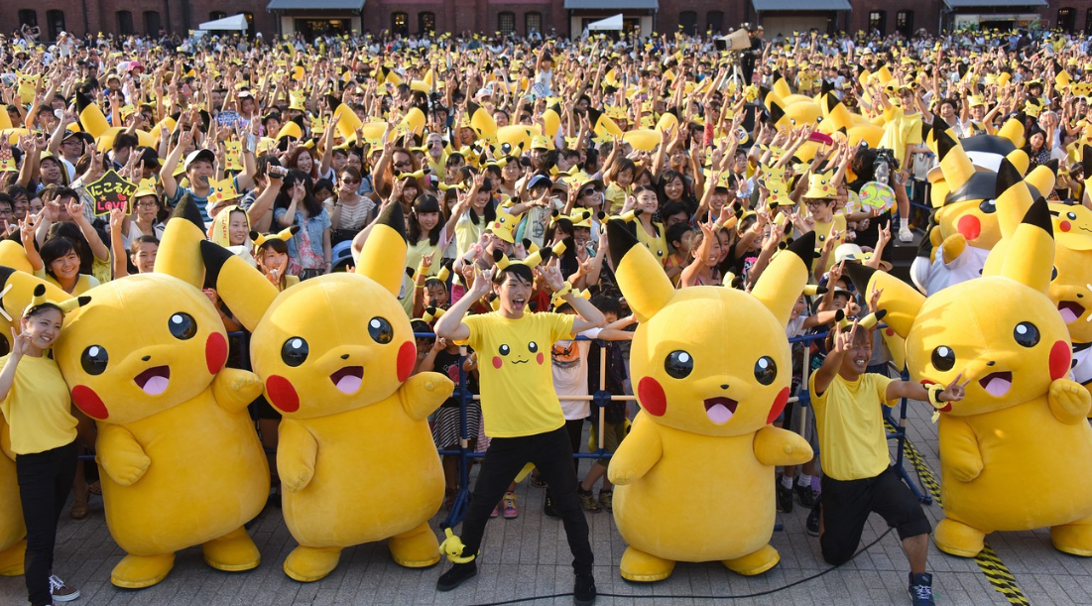
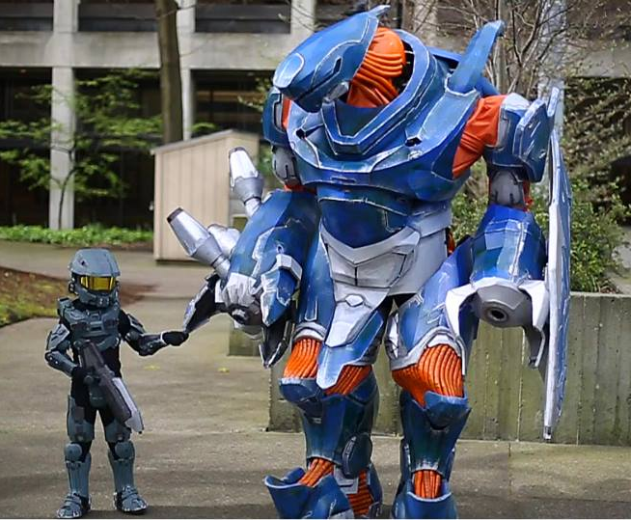
Network – Customers
Your customers are the people that buy your product. From a game developers' perspective, this is likely the people that play your game.
Engage with your customers, listen to their feedback, & build a community for your brand.
Players who feel like they can engage with your games, your business, and your brand are more likely to view your games favorably and become advocates for your work.

Slide 9

Network – Clients
If you are doing freelance and contract work, it is important to build up your network of client, stay in touch and seek new clients.
Connecting with clients on social networks will enable you to keep them updated on your business.
When previous clients in your network need development services, they will naturally think of your business.
This will also be helpful in getting new clients and jobs, as your existing network are more likely to refer you if you are regularly engaging with them on social networks.

Slide 10
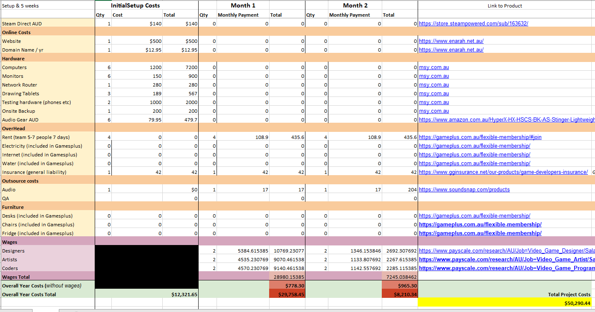

Business – Bookkeeping and Tax Obligations
As a business it is your obligation to keep accurate financial records and pay tax on your profits.
Bookkeeping is the process of regularly recording on a company's financial transactions.
This allows you to accurately keep track of your expenses and income & the financial state of your business.
When tax time comes you will be able to easily work out your taxable income.

Slide 11
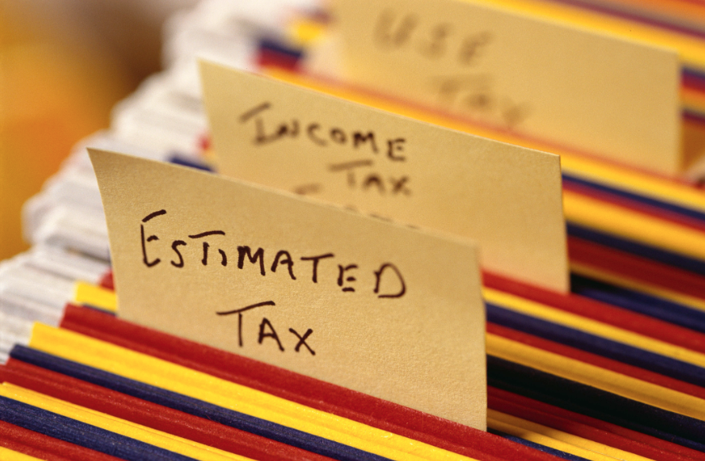
Tax Obligations – Goods and Services Tax (GST)
In Australia GST is applied to all goods and services at a flat rate of 10%.
As a Sole Trader you are exempt from registering for GST unless you have a gross income (before expenses are taken out) of less than $75 000 per year.
If you are registered for GST or if you are a company:
You must collect GST on all your sales and services.
This must be paid to the Tax Office.
You can claim back GST on all your business expenses.
This will be returned to you from the Tax Office.
A business that is registered for GST will be sent a quarterly Business Activity Statement (BAS).
A BAS reports your GST obligations & any income tax you have withheld for employees. (PAYG - pay as you go)
Notes:
https://www.ato.gov.au/Business/GST/Registering-for-GST/
https://www.ato.gov.au/Business/Business-activity-statements-(BAS)/
https://www.ato.gov.au/business/business-activity-statements-(bas)/pay-as-you-go-(payg)-withholding/

Slide 12

Questions?

